Slide 1
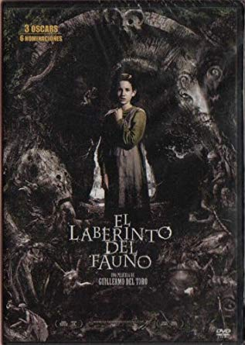
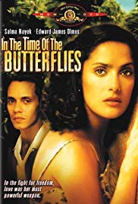
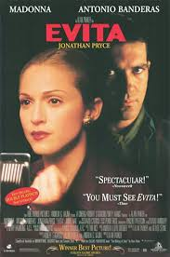
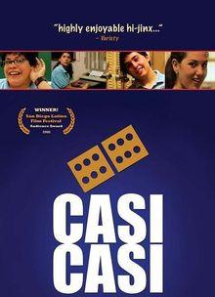
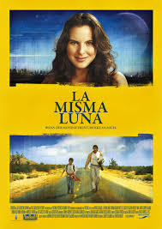
La Cinema Por Los Ojos De Latinos
Cinema through the eyes of Latinos

Slide 2
Course description: Four main topics
Immigration,
Magic Realism,
Political History of Latin American Countries
Culture of Latinos and Hispanics
We will delve into the theme and motifs of each film and how it is connected to one of the 4 topics but we will also discuss film techniques that the directors used, through vocabulary of cinematography.
If you are interested in films, this would be a good elective to choose. You will not only enhance your knowledge of hispanic and latino history and culture but also learn about various techniques that directors use in film.

Slide 3
Topics | Movies
Immigration - Understanding the strife of a pilgrimage to another country. | Bajo La Misma Luna (Under The Same Moon)
Magic Realism - Understanding the history and usage of magic realism in literature | El Laberinto de Pan (Pan's Labyrinth)
Historical Events and People in Latin American countries - Understanding the historical significance of people and events that have take place in Latin American history | En el Tiempo de Las Mariposas (In the Time of the Butterflies) Evita (The story of Eva Peron)
Culture - Understanding coloquial conversational vocabulary and cultural celebrations in Latin American countries | Casi, Casi (Almost) Coco

Slide 4
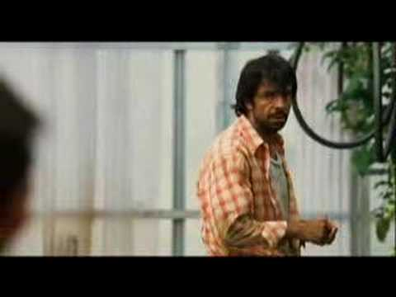
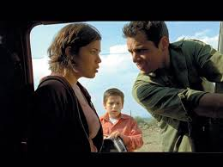
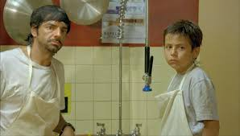
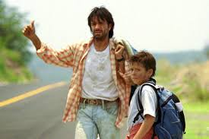
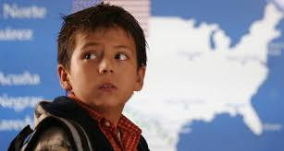
Bajo la misma luna: Immigration
https://www.youtube.com/watch?v=9jCZgUiPixE
A young Mexican boy illegally travels to the U.S. to find his mother (who is illegally in the U.S.) after his grandmother passes away.
Director: Patricia Riggen

Slide 5
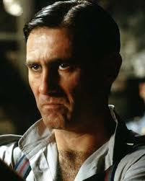
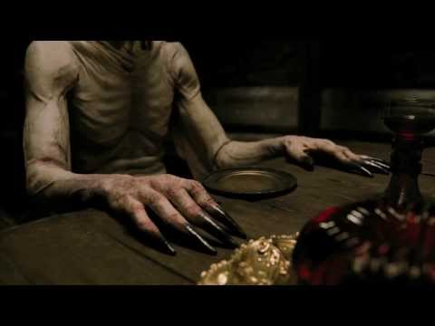
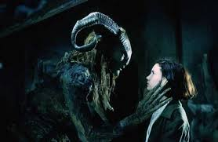
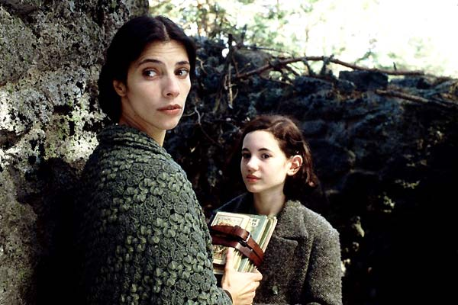
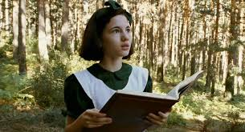
El Laberinto del Fauno/Pan:Magic Realism
https://www.youtube.com/watch?v=E7XGNPXdlGQ
In the falangist Spain of 1944, the bookish young stepdaughter of a sadistic army officer escapes into an eerie but captivating fantasy world.
Director: Guillermo del Toro

Slide 6
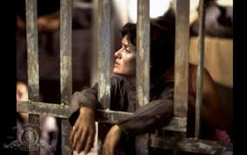
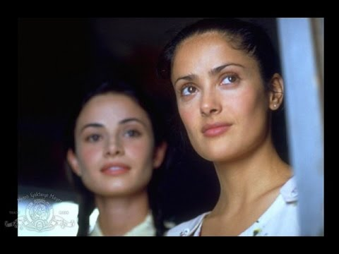
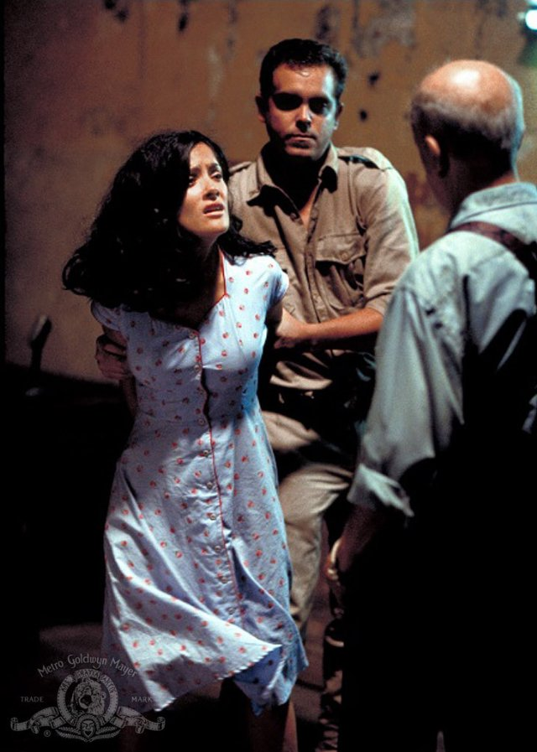
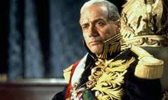
En el tiempo de las mariposas: Historical Events/People
https://www.youtube.com/watch?v=jo3ewX1-sd0
In the Time of the Butterflies is inspired by the true story of the three Mirabal sisters who, in 1960, were murdered for their part in an underground plot to overthrow the government.
Director: Mariano Barroso

Slide 7
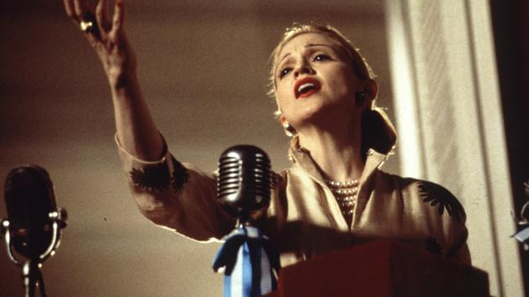
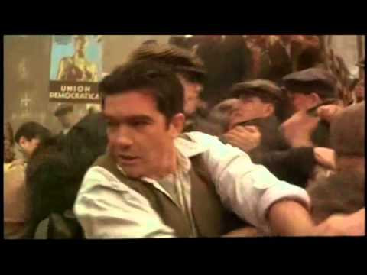
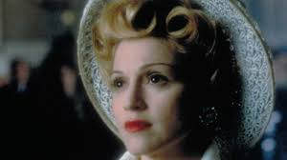
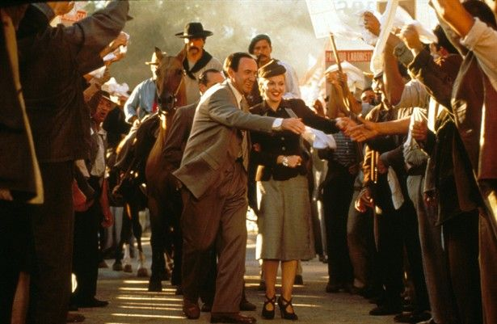
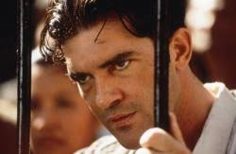
Evita:Historical events
https://www.youtube.com/watch?v=Z88KbXcDd5o
The hit musical based on the life of Evita Duarte, a B-picture Argentinian actress who eventually became the wife of Argentinian president Juan Perón, and the most beloved and hated woman in Argentina.
Director: Alan Parker

Slide 8
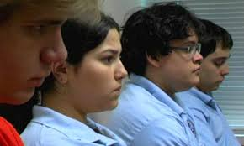
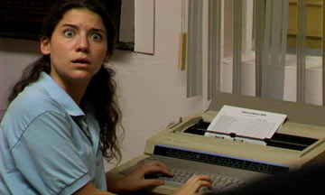
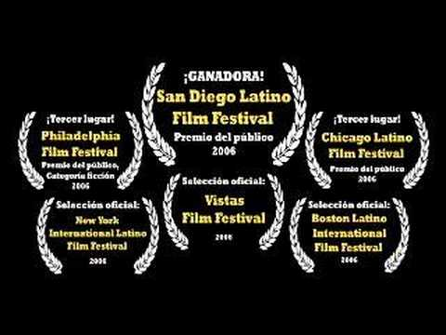
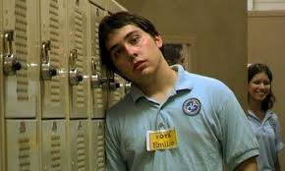
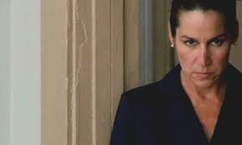
Casi Casi: Cultural
https://www.youtube.com/watch?v=rth_GbZW5Cg
Running for Student Council President will impress the popular girl, until she decides she wants to be president, too.
Director: Jamie Valles and Tony Valles

Slide 9
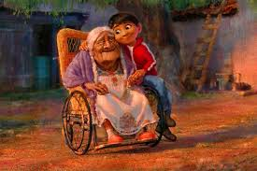
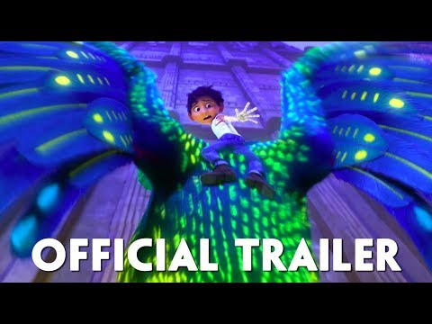
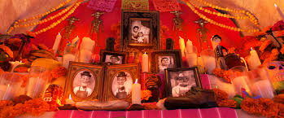
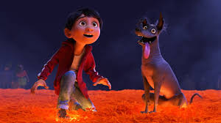
Coco: Culture
https://www.youtube.com/watch?v=Rvr68u6k5sI
Aspiring musician Miguel, confronted with his family's ancestral ban on music, enters the Land of the Dead to find his great-great-grandfather, a legendary singer.
Director: Lee Unkrich

Slide 10
Directors
These are the directors of the films that we will watch.
Patricia Riggen
Guillermo del Toro
Mariano Barroso
Alan Parker
Jamie Valles and Tony Valles
Lee Unkrich
We will discuss the filming techniques they used in the film and why they might have chosen that particular technique.

Slide 11
Cinematography
These are some filming techniques that we will be discussing:
Camera angles
Candle Lighting
Cross-cutting
Cross-fade
Deadpan
Directing the eye
Flashback
Flash forward
Mise en scene
Narration
Overture
Pan and scan
Product placement
Pull back
Rack--focusing
Slow motion
Soft-focus
Tiltshop
Time lapse
vignette

Slide 12
Goals and Course Objectives
Course Goals and/or Major Student Outcomes:
Show students different aspects of Latin American and Spanish culture through film.
Broaden student knowledge of Latin American and Spanish culture, history and literature
Introduce students to the coloquial and conversational vocabulary of Latin American and Spanish Cultures through film.
Shows students how film techniques have been used to demonstrate themes of the film.
Course Objectives:
Students will be able to explain and relate to different aspects of the Latin American and Spanish cultures
Students will be able to understand and explain the historical and cultural significance of each film.
Students will be able to describe the technique of magic realism in Spanish literature.
Students will be able to communicate using culturally appropriate vocabulary associated with a broad range of topics.
Students will be able to demonstrate themes of the film through discussions and assessments.

